Slide 1
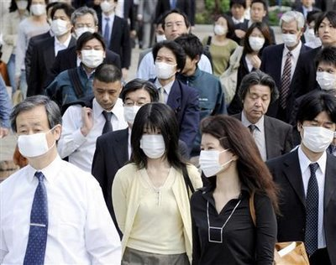
Human Health and the Environment
“The diseases of the present have little in common with the diseases of the past save that we die of them. ” - Agnes Repplier

Slide 2
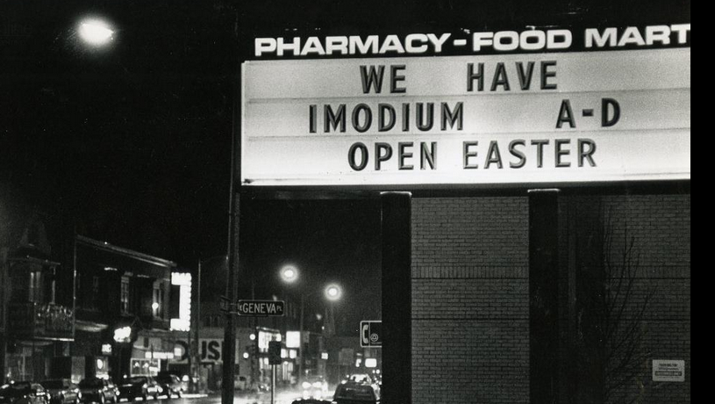
The Milwaukee Outbreak
In the early spring of 1993, the city of Milwaukee had all the signs of an outbreak of some kind of intestinal disease.
Absentee rates in schools and workplace skyrocketed.
Drug stores were struggling to stay stocked with anti-diarrheal medication.
Photo by Jeffrey Phelps, from the Milwaukee Journal-Sentinel

Slide 3
Monsters Inside Me, Season 1, Episode 2 “Outbreak”

Slide 4
The Milwaukee Outbreak
Residents were advised to drink more water and stay hydrated in the hopes that the illness would subside.
The state department of health joined the city in investigating the cause.
At its peak, the disease affected an estimated 403,000 of the city’s total population of 1.6 million residents.
Most afflicted were people living on the south side of the city.

Slide 5
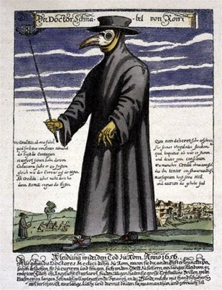
Disease Treatment in History
Prior to the 19th century, many scholars followed the miasma theory of disease, from the middle ages up through the 1800s.
Diseases were caused by a poisonous vapor or mist filled with particles from decomposed matter.
During the Black Death, doctors wore costumes that included masks containing dried flowers, herbs, spices, and a vinegar sponge.
A Plague Doctor. Source unknown.

Slide 6
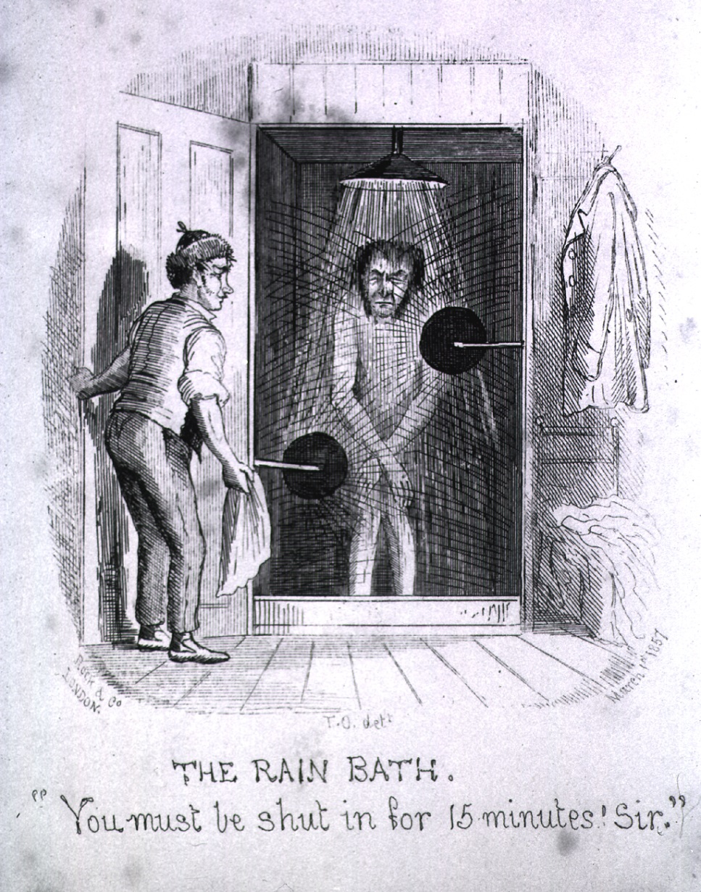
Other common treatments of disease:
Bloodletting –Bleeding a patient to restore the balance of the four “humours”; blood, phlegm, black bile, and yellow bile.
Water cure – Icy cold water was applied to draw blood away from the injured or affected organs.
The Rain Bath by Thomas Onwhyn, 1857

Slide 7
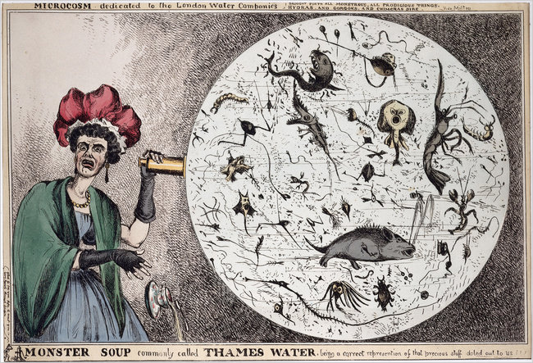
The Medical Revolution
Eventually, a major discovery changed the entire practice of medicine.
The Germ Theory of Disease states that some diseases are caused by microorganisms, too small to see without magnification.
Monster Soup commonly called Thames Water by William Heath, 1828.

Slide 8
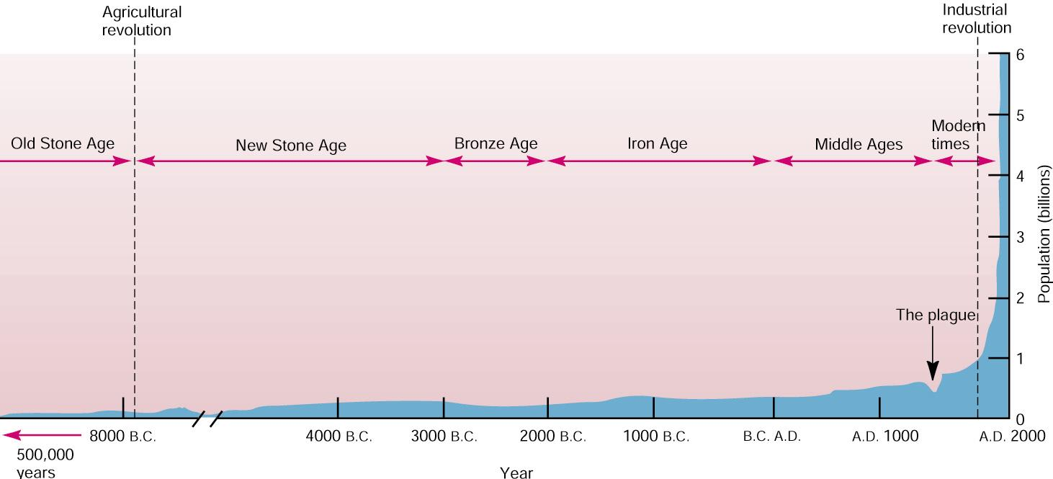
As the cause of major diseases became better understood, more effective treatments became available.
Immunizations
Antibiotics
These discoveries coincide with the beginning of exponential human growth.

Slide 9
Infectious Disease
Non-transmissible diseases are not caused by living organisms and are not contagious.
Heart disease, cancer, asthma, diabetes
Infectious diseases are caused by living organisms and are usually transmissible.
There are many different types of microorganisms that can cause disease.
Multicellular organisms are made of many cells working together.
Unicellular organisms consist of only one cell.
Prokaryotes are cells without a nucleus and organelles.
Eukaryotes are cells with both a nucleus and organelles.
Much larger than prokaryotes.

Slide 10
Infectious Agents
Parasites are eukaryotic organisms can be either unicellular or multicellular. They cause disease by extracting resources from a host.
Tapeworm
Trichinella (roundworms)
Liver flukes
Fungi are also eukaryotic and multicellular. Most are decomposers but some can invade living tissue.
Athlete’s foot
Ringworm (not an actual worm)

Slide 11
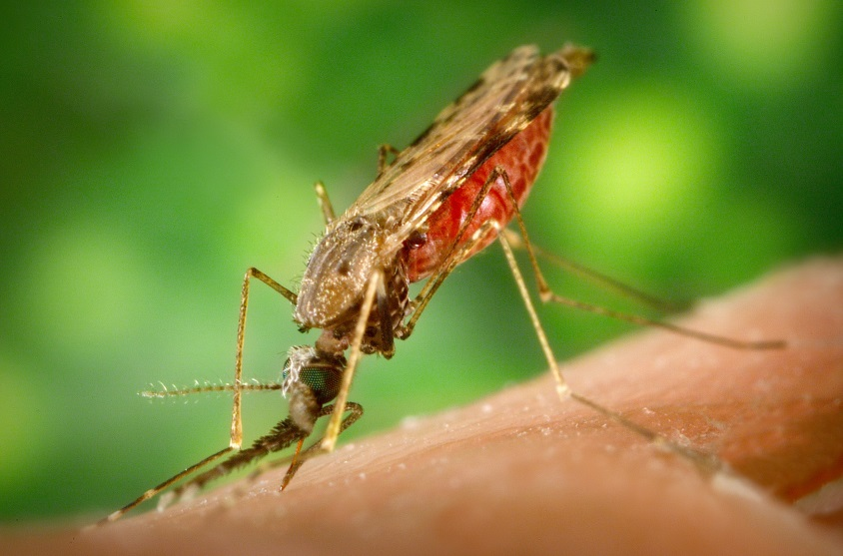
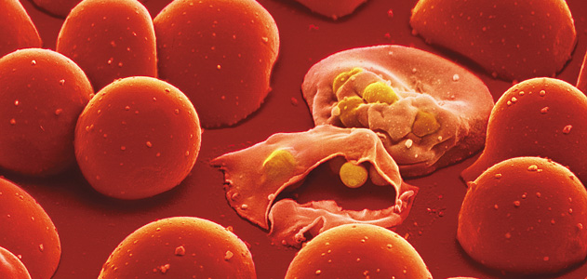
Protozoa are unicellular eukaryotic organisms. Like fungi, most are harmless but some can cause disease.
The historically most deadly human disease, malaria, is caused by a protozoa called plasmodium.
Plasmodium invading and killing two red blood cells.
The mosquito that spreads malaria, called Anopheles.

Slide 12
Bacteria are unicellular prokaryotic organisms.
Food poisoning (E. Coli, salmonella), staph infection.
Viruses are not cells. They are non-living particles made from a core of RNA surrounded by a protein coat.
Influenza, common cold, AIDS.

Slide 13
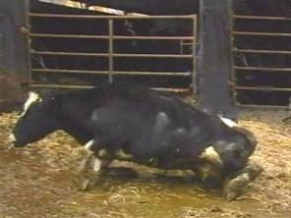
Prions are proteins with abnormal shapes.
Convert normal proteins when they come into contact.
Brain tissue is affected, leading to death.
Mad cow disease and its human form, Creutzfeldt-Jakob disease, are caused by prions spread by the ingestion of nervous tissue (brain and spinal cord).

Slide 14
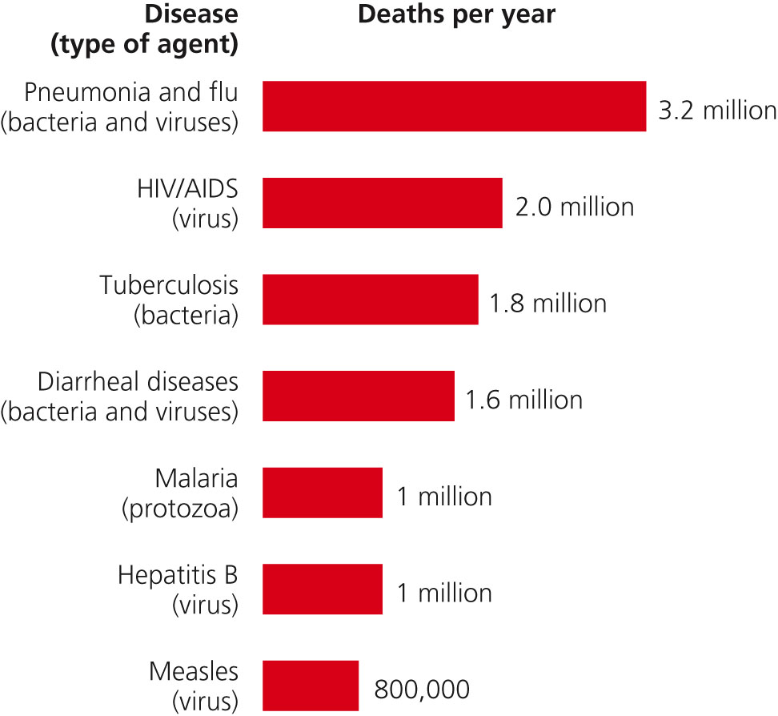
Seven Deadliest Diseases
Source: Miller Environmental Science

Slide 15
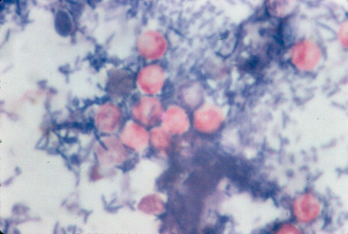
The intestinal disease outbreak in Milwaukee was a mystery because all of the stool samples taken by doctors tested negative for the typical viruses and bacteria.
The director of the city health department decided to test for something unusual – protozoan parasites.
The tests were positive for a very small, rare parasite called Cryptosporidium.
An acid-fast stain of stool, showing the Cryptosporidium cysts in red.

Slide 16
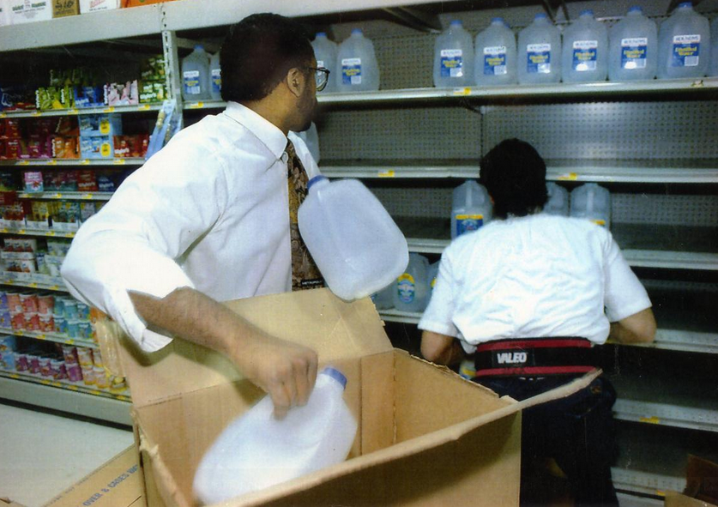
The parasite could only have spread so quickly by water.
A boil alert was immediately placed on all municipal tap water.
Two employees restock bottled water at a Milwaukee grocery store. Source: Milwaukee Journal-Sentinel.

Slide 17
Monsters Inside Me, Season 1, Episode 2 “Outbreak”

Slide 18
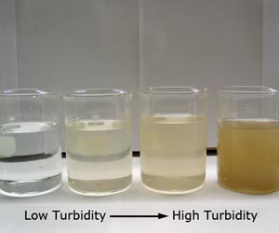
An investigation of a south Milwaukee water treatment plant found a cloud highly turbid water had passed through the plant just as the outbreak began.
By the time the source of the outbreak was known, the parasite cloud had passed.

Slide 19
Emergent Diseases
An emergent disease is one not previously known or existed previously but has re-emerged.
Many emergent diseases originated from a non-human animal species.
HIV originated in chimpanzees.
SARS came from the Masked Palm Civet, which is native to China.
Influenza H1N1 is believed to have started in a swine farm in mexico.
The Spanish Flu of 1918, which killed 50-100 million people worldwide, may have originated from a swine or avian source.

Slide 20
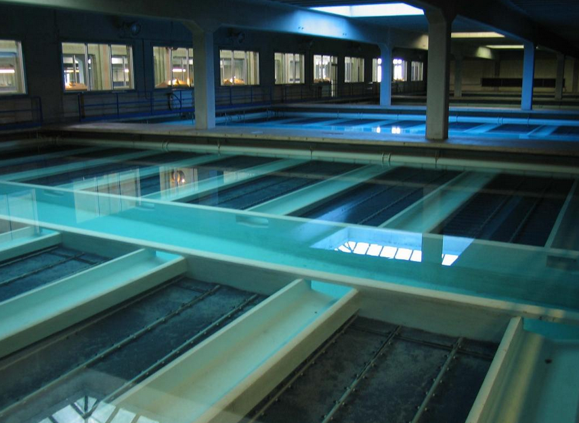
Milwaukee’s intestinal parasite outbreak came to an end as the filters at the water treatment plant were cleaned and eventually upgraded.
Cryptosporidiosis was treated as an emergent disease, because the outbreak was so unusual.
Later tests showed the parasites actually entered from the outlet of a sewage treatment plant 2 miles upstream.
Water filtration plants are now upgraded to prevent future parasite infestations.
Linwood water filtration plant, Milwaukee.

Slide 21
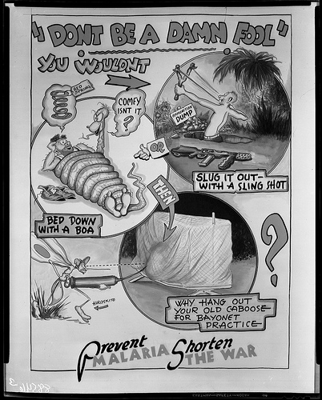
Preventing and Treating Disease
The strategy used to deal with infectious disease depends on the agent causing it, and how it is spread.
Malaria was an especially big problem during the South Pacific invasion in World War II.
In 1942, nearly a third of soldiers on both sides had malaria.

Slide 22
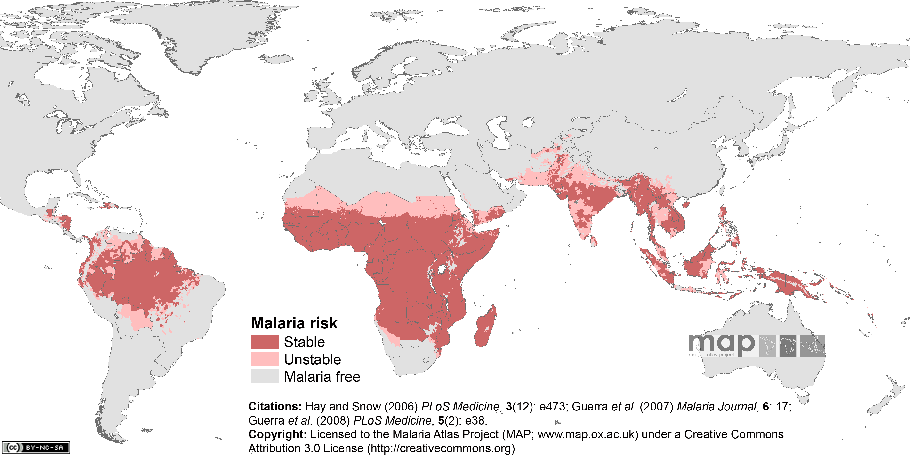
The protozoan parasite that causes malaria can only thrive where it can access both its mosquito and human hosts.
Warm, humid climates.

Slide 23
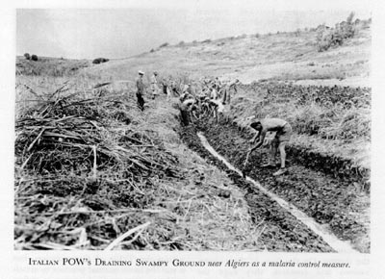
During the 1940s through the 1960s, the spread of malaria was slowed with three strategies:
Applying massive amounts of pesticides to kill mosquitoes.
Treating infected individuals with antimalarial drugs to kill the protozoan parasite.
Draining wetland areas where mosquitos breed.

Slide 24
The Winged Scourge. Disney, 1943.

Slide 25
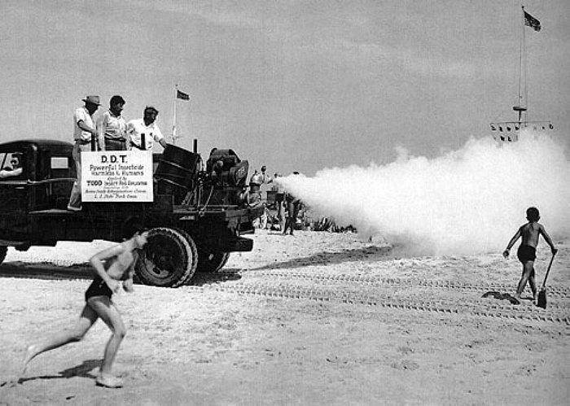
Resistance
Anti-malarial medication and pesticides became much less effective over time, as the parasites and insects each developed resistance; the ability to survive after exposure.
Spraying DDT at Jones Beach, Long Island, NY. 1953.

Slide 26
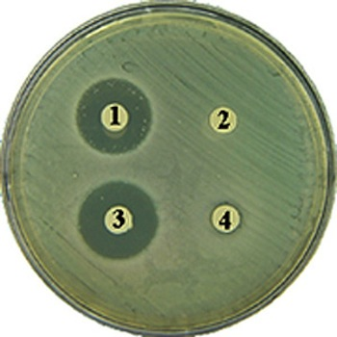
Antibiotics
Antibiotics are medications that slow down the growth of or destroy bacteria.
Due to their small size and ability to reproduce so quickly, bacteria can evolve resistance even more quickly than insects and protozoa.
Bacterial growth on a petri dish. The colony shows resistance to antibiotics 2 and 4.

Slide 27
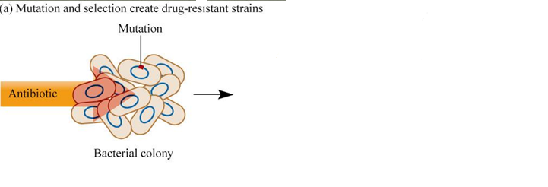
When an antibiotic is first applied to a colony of bacteria, one individual may have a mutation that gives it resistance.

Slide 28
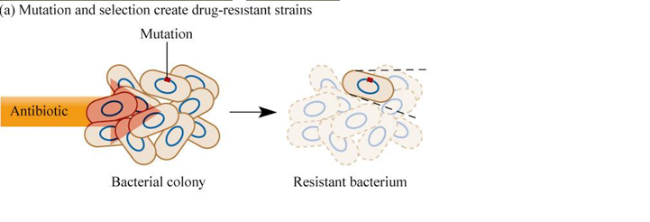
That individual will survive, while the rest of the colony is destroyed.

Slide 29
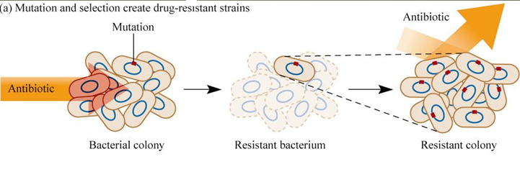
Bacteria can reproduce asexually, so the surviving individual can regenerate the entire colony.
The entire colony is now resistant.

Slide 30
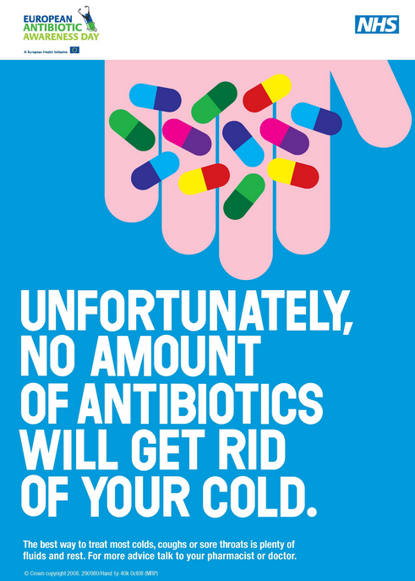
Antibiotic Misuse
Many antibiotics (penicillin, amoxicillin) do not work against certain diseases.
Reasons for antibiotic resistance to develop:
Antibiotics prescribed for a viral infection.
Antibiotics are given when the person could recover fully without them.
Starting and not finishing a full prescription.
Widespread use of antibiotics in animal agriculture.

Slide 31
Chemical Toxins
A chemical that can cause temporary or permanent harm or death to a living organism is considered toxic.
Toxins are labeled according to what body systems they affect.
Mutagens damage the DNA within cells, increasing the frequency of mutations.

Slide 32
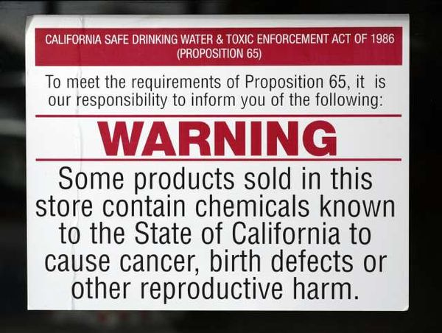
Carcinogens are chemicals, forms of radiation, or viruses that increase the risk of cancer.
Arsenic
Benzene
Formaldehyde
Tobacco smoke
UV radiation
Teratogens are chemicals that cause birth defects in an unborn fetus.
Ethanol
Benzene
Lead
Mercury

Slide 33
Neurotoxins are chemicals known to disrupt the function of the brain, spinal cord, and other nerves.
Mercury can cause sensory impairment, lack of coordination, and disrupt other nervous system functions.
Lead, another neurotoxin, was used as an additive in gasoline until 1976.
Following a ban of its use, an 80% drop in blood lead levels were observed, as well as a 6-point gain the average IQ of children.

Slide 34
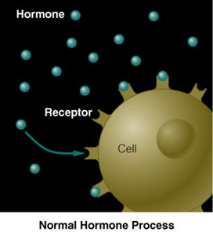
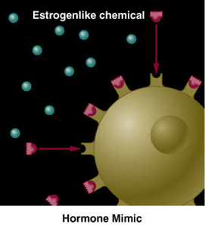
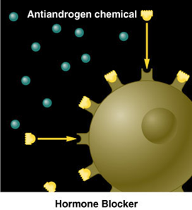
Endocrine hormone disruptors interfere with the function of normal chemical messengers in the body.
Hormone mimics have similar shapes to natural hormones and amply their effects.
Hormone blockers prevent natural hormones from attaching to their target organ.

Slide 35
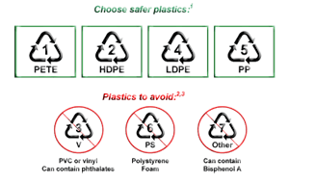
One commonly used chemical called BPA is known to be a hormone mimic.
BPA is found in many plastics, as well as the linings of cans and boxes used in food packaging.
Scientists disagree over the population effects of BPA, and its use in the United States is still legal.
Safer plastics guide, published by the New Jersey Dept. of Human Resources

Slide 36
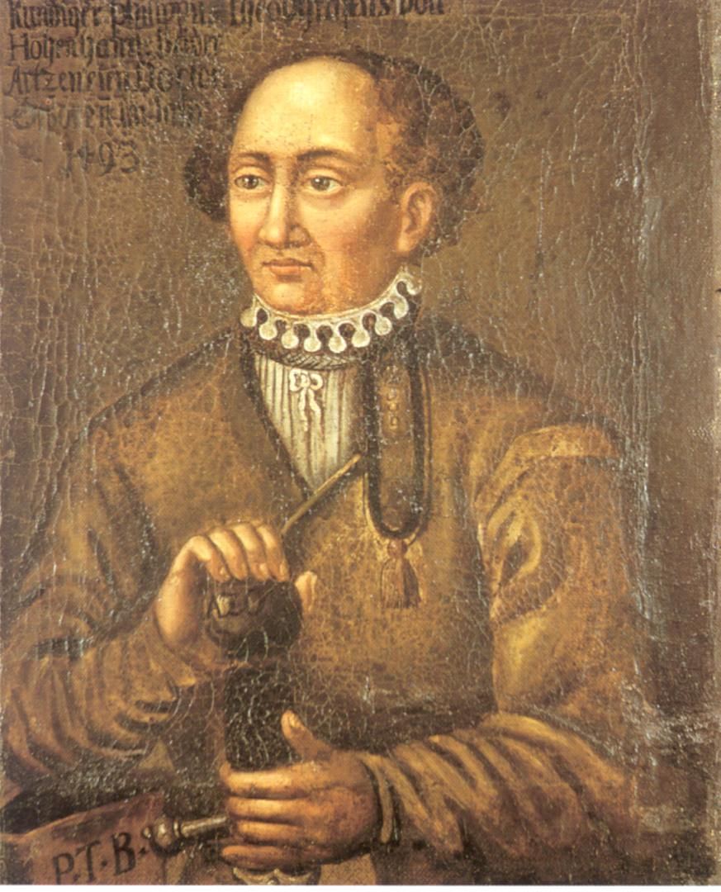
Evaluating Toxins
We are exposed to small amounts of potentially harmful chemicals every day.
Toxicity is the measure of how harmful a substance is to the health of living organisms.
Any synthetic or natural chemical has the potential to cause harm if the level of exposure is high enough.
“The dose makes the poison.”
Paracelsus, German scientist, 1493-1541.

Slide 37
Factors Influencing Toxicity
There are many individual genetic differences in sensitivities.
The solubility of a substance; whether it can dissolve in oil or water.
Water-soluble toxins tend to be passed through the body via the kidneys fairly easily.
Oil-soluble toxins, once ingested, can pass directly into cells and tissues, allowing them to accumulate.
Chemicals with a high level of persistence that do not degrade easily are more likely to cause long-term effects.

Slide 38
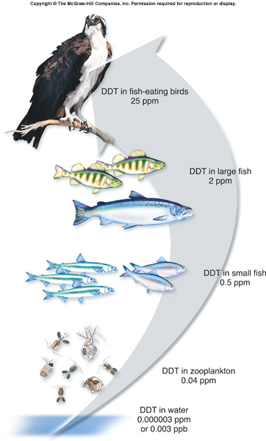
Chemicals with a high level of persistence, like DDT, are more likely to undergo biomagnification.
As the substances passes up a food chain, it accumulates at higher (and more toxic levels).

Slide 39
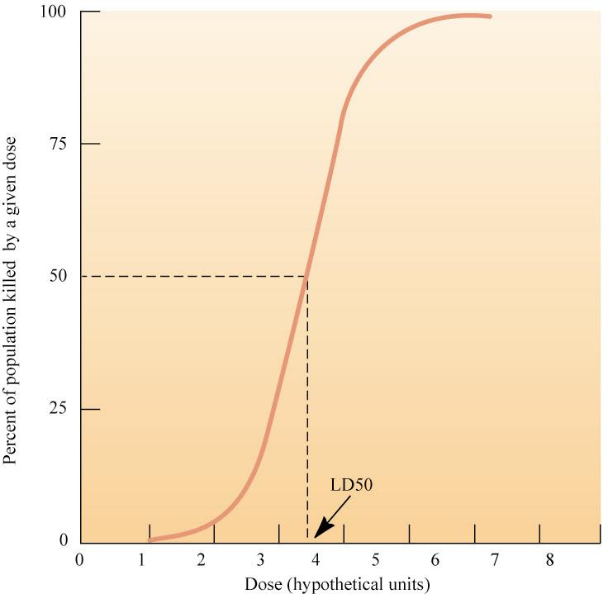
One of the most widely-accepted approaches to measuring toxicity is to expose populations of laboratory animals (usually rats or mice) to increasing doses of the chemical.
The mortality, or percentage of the population killed by this dose is measured and graphed.
A chemical’s LD50 is the dose that will kill 50% of the test population within a given period of time.
Lower LD50 values indicate deadlier toxins.

Slide 40
Substance | LD50 (mg/kg)
Table sugar | 29,700
Monosodium Glutamate (MSG) | 16,600
Vitamin C | 11,900
Alcohol (Ethanol) | 7,060
Table salt | 3,000
Aspirin | 200
Caffeine | 192
Nicotine | 50
Capsaicin (active component of chili peppers) | 47.2
Poison Dart Frog Toxin | 0.002
Polonium-210 (Nuclear Waste) | 0.000000001

Slide 41
Risk Assessment
Risk Assessment is estimating the likeliness or severity of a specific hazard to human health.
Hazards could include injury or death as a result of diet, infectious disease, or toxic chemicals.
Individual risk assessment tends to be biased.
Sensationalization of rare events by the media or politicians.
Misunderstanding of statistics.
Personal experience with a specific hazard or toxin.
Fear of the unknown.

Slide 42
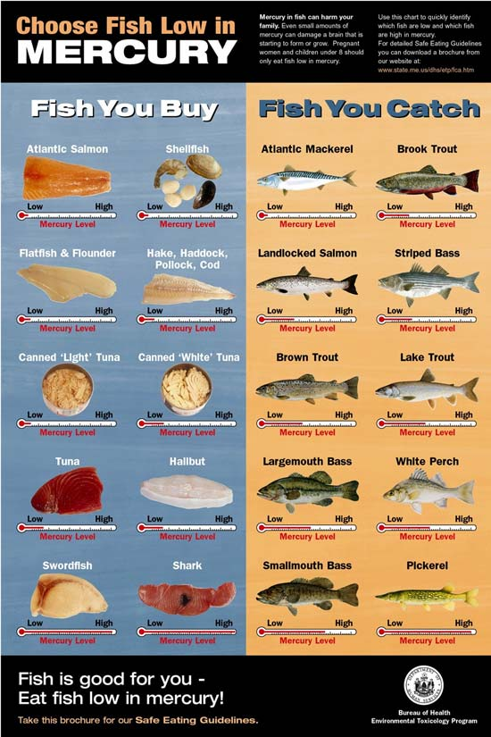
What risks are generally considered acceptable?
High probability of exposure with low severity.
Mercury in seafood.
Low probability of exposure with high severity.
Nuclear power plants.

Slide 43
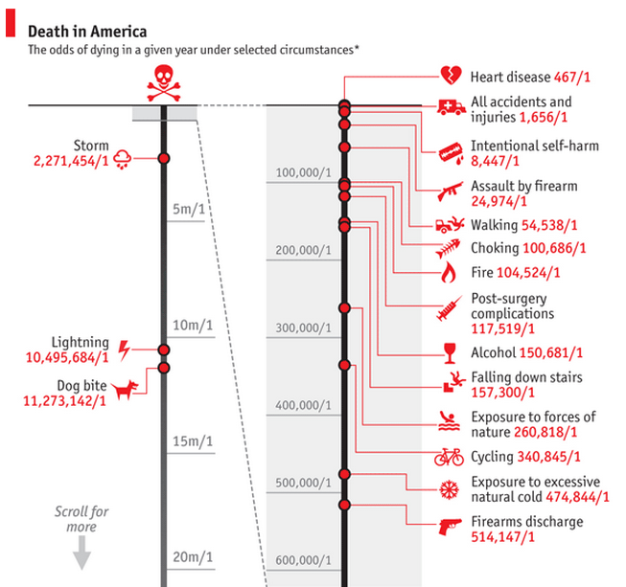
Public policy decisions are made based on risk assessment and promoting the best health possible in the population.

Slide 44
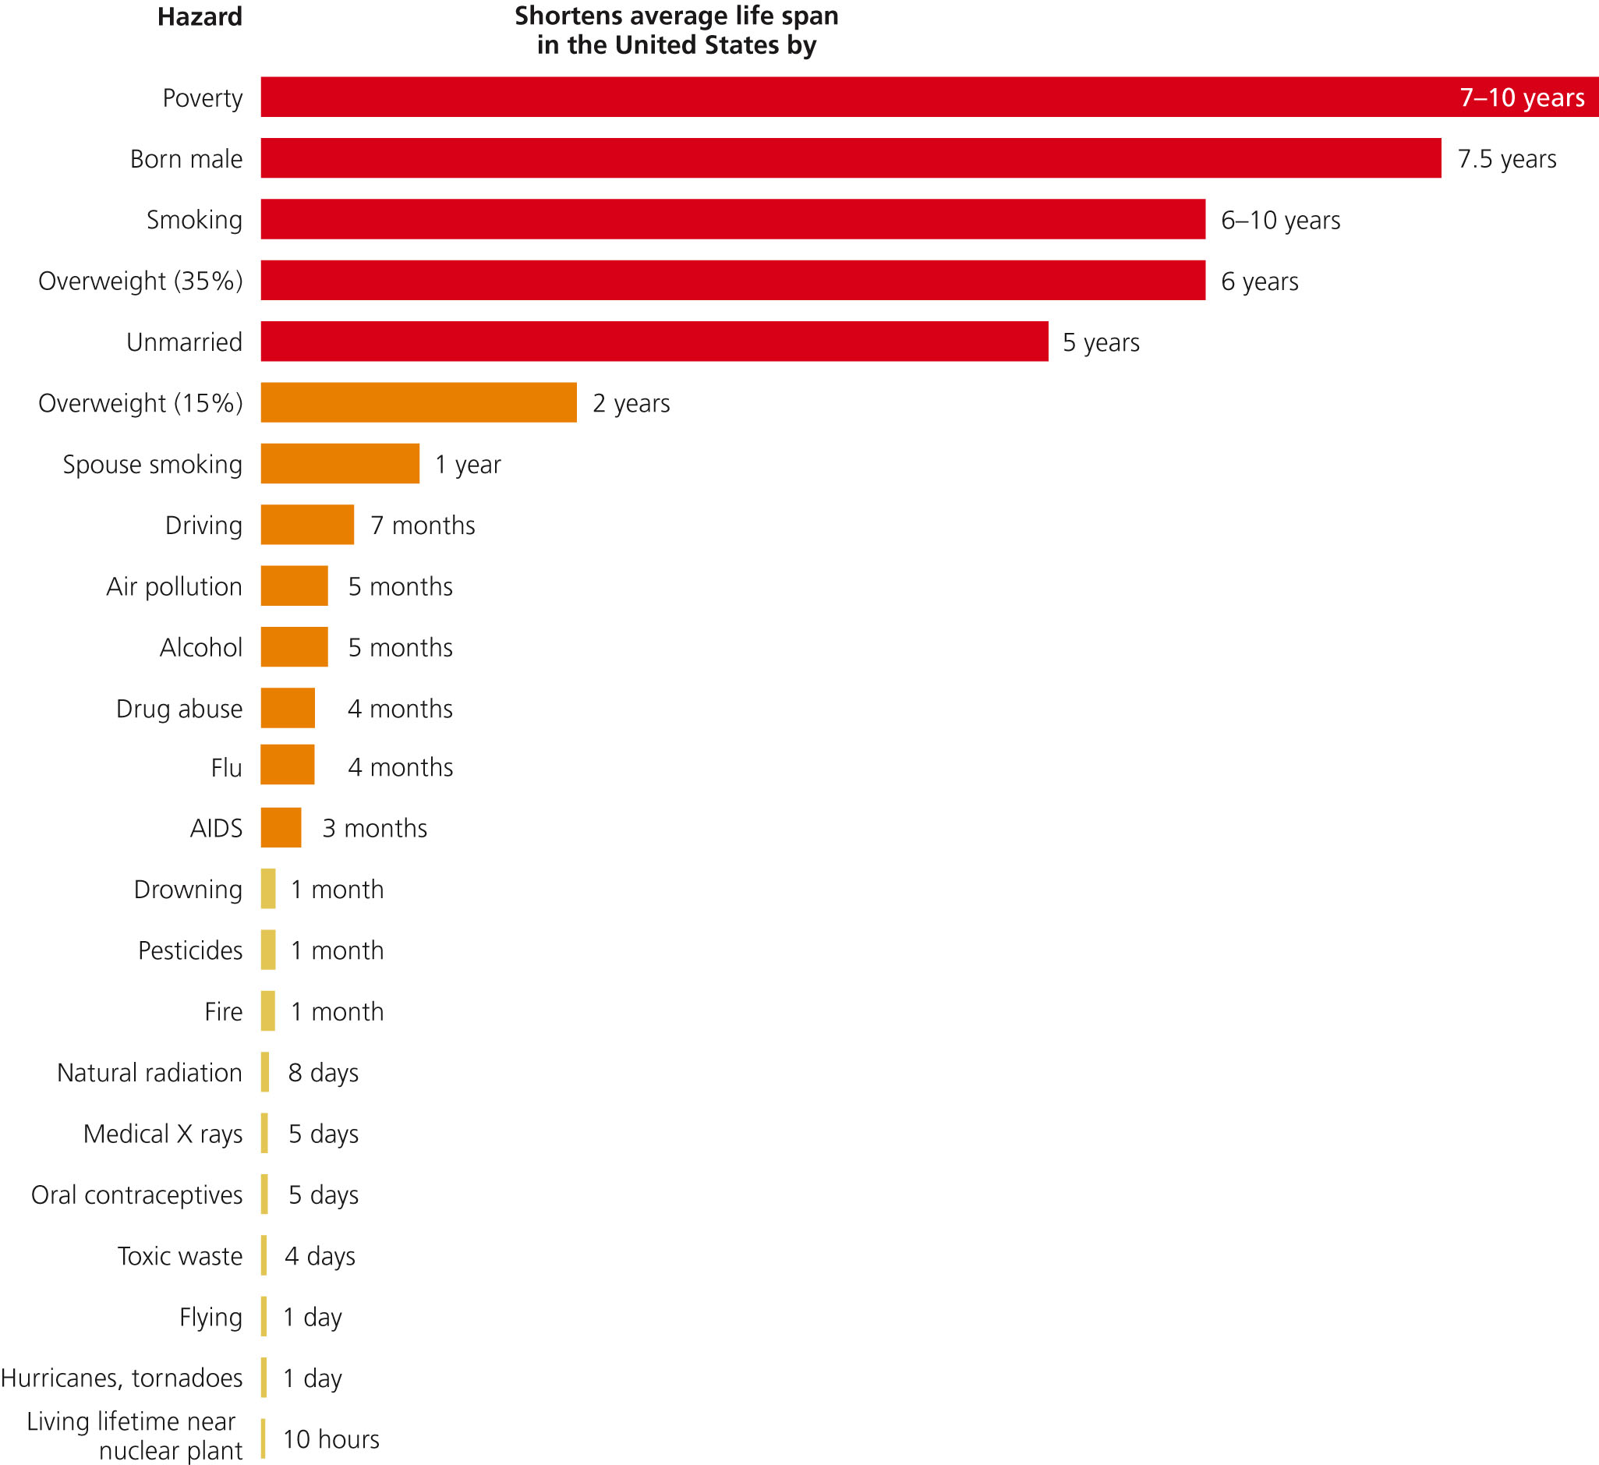
Source: Miller Environmental Science

Slide 45
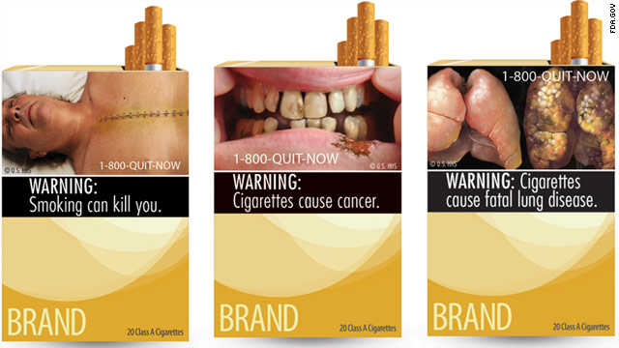
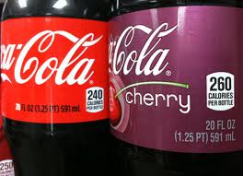
These are examples of labels that have been required or proposed as a result of public health concerns.

